Slide 1


Slide 2
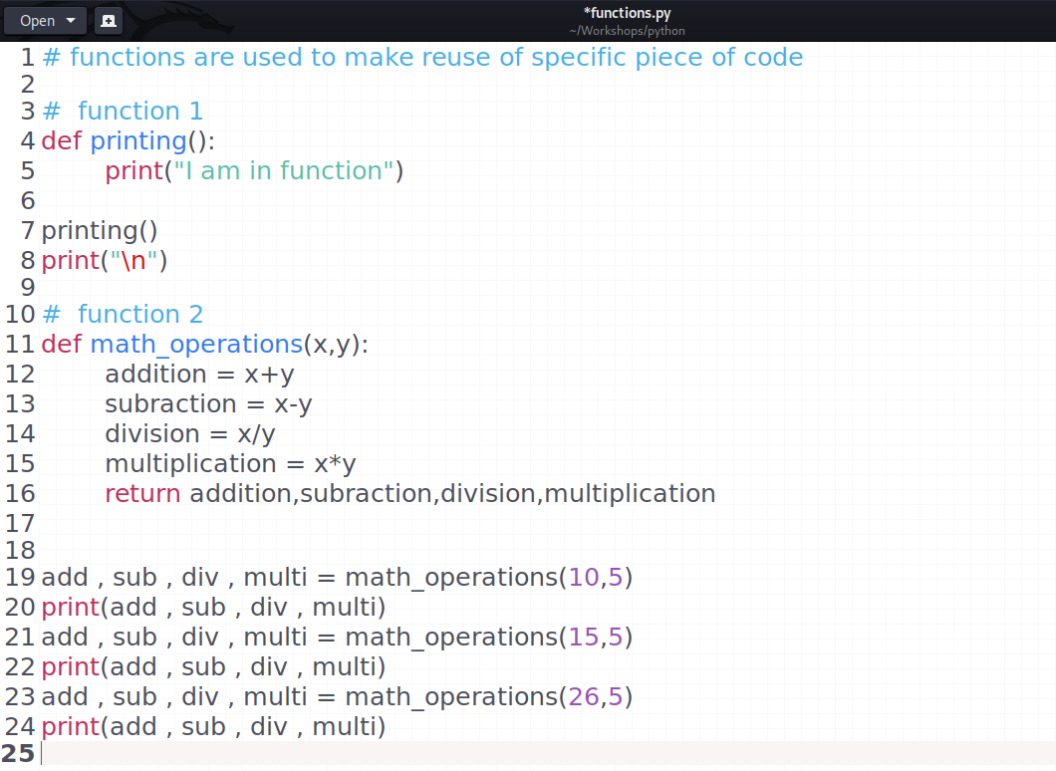
Functions

Slide 3
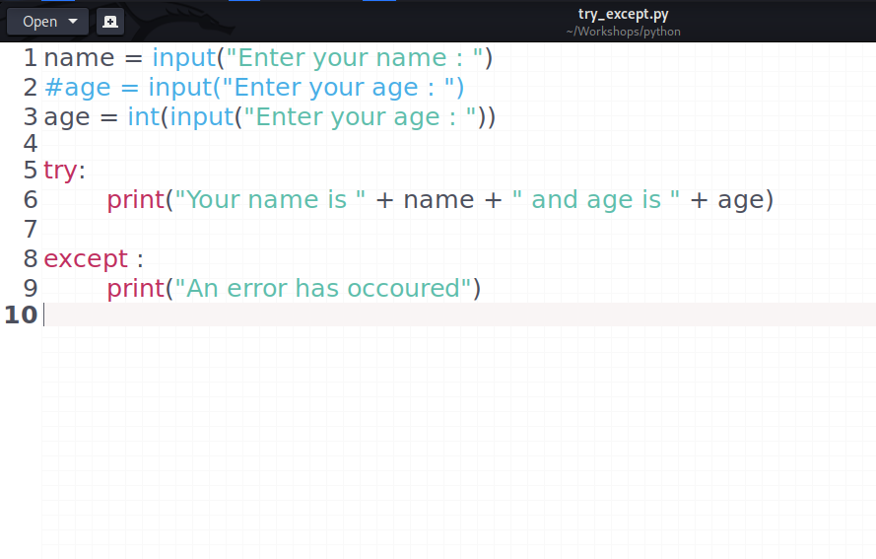
Try-Except

Slide 4
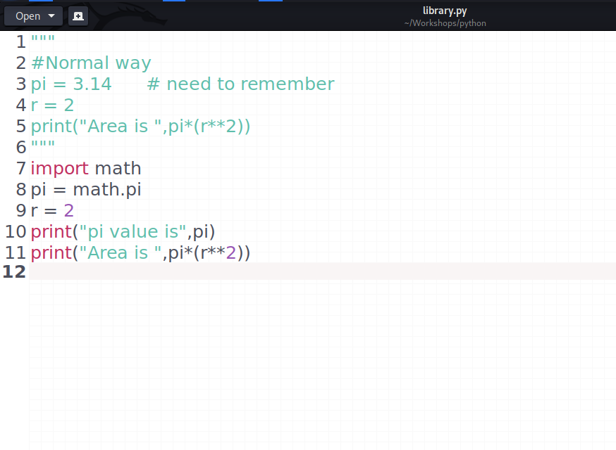
Library

Slide 5
Are You Ready For Keylogger ??
Requirements :-
Library :- pynput, threading, smtplib [pip install pynput]
(Documentation :- https://pypi.org/project/pynput/)
An IDE :- Either Linux or Any on windows like vs-code, sublime, etc

Slide 6
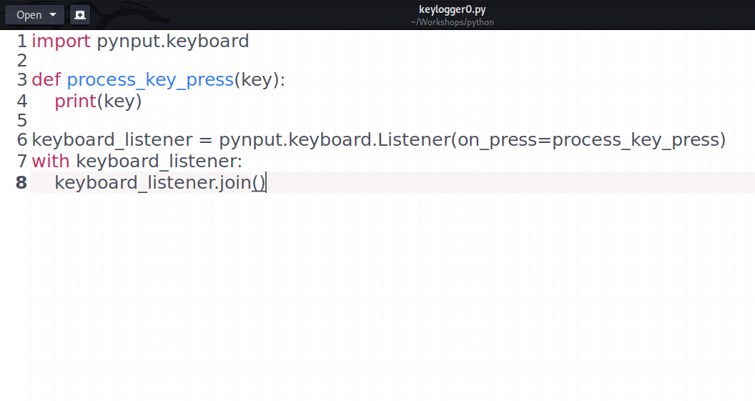
Step 1
Basic Local key logging

Slide 7
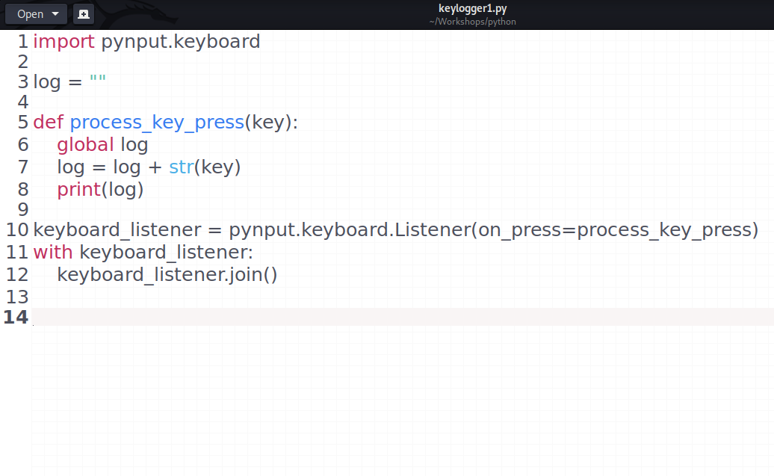
Step 2
Combine in sentence

Slide 8
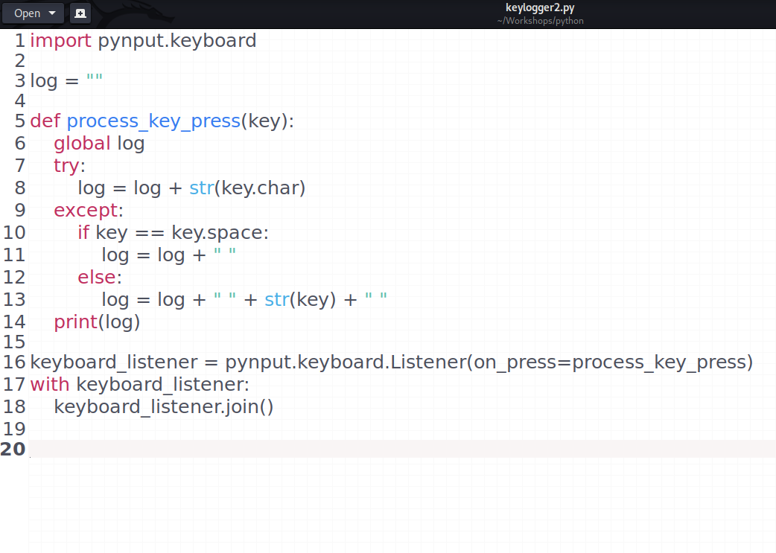
Step 3
Improving Code

Slide 9
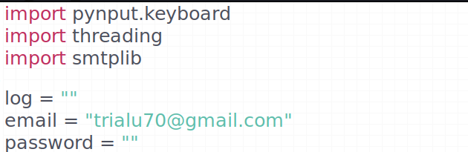
Step 4
Adding email and password as global variable

Slide 10
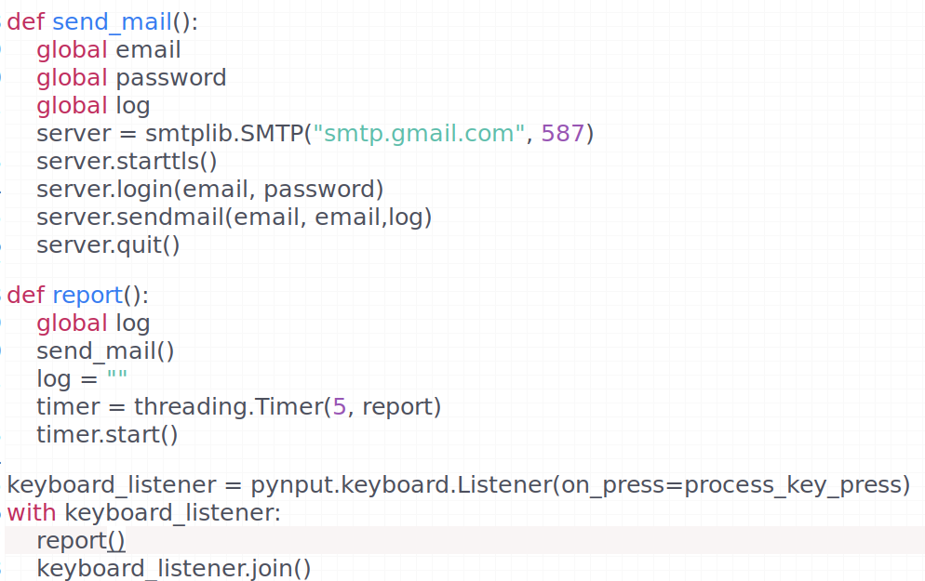
Step 5
Sending to email

Slide 11

Threading
Code
Key listener working parallely
Report function run in every 5 (as per wish) sec

Slide 12
Your keylogger is ready !!!!!

Slide 13

Thank You
Keep Hacking…

